Slide 1
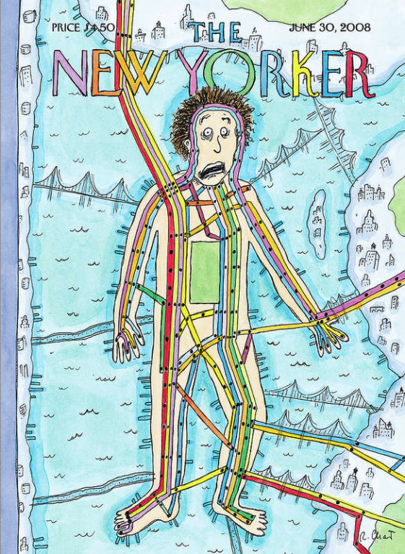

NYC Subway Ridership Changes from 2018 through 2021
BEFORE & DURING THE PANDEMIC
Francesca Piccorelli

Slide 2
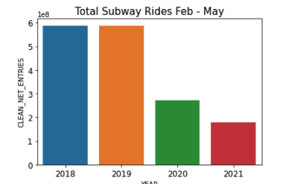
Introduction
The goal of this project was to get a sense of how COVID-19 has altered the use of the NYC subway system.
This data can be used to enhance train scheduling needs, predict future patterns, and better understand how the city is adapting to these changes.
As one of many people in the tri-state area who went from being a daily rider to working from home, I am personally interested in seeing how the pandemic impacted overall ridership trends.
The most consistent conclusion that can be drawn is that total rides have decreased by about 1/3 from 2018 – 2021.

Slide 3
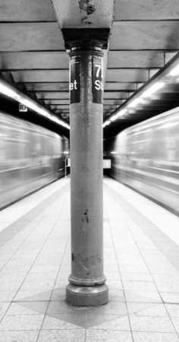
Methodology
SQLite & SQLAlchemy were used to select the 16 months spanning 4 years so that the sample would be manageable enough to load for analysis.
To account for the 4 turnstile ID columns and the cumulative (not net) data, the database was double sorted in pandas (1st by unique turnstile, and then by descending by date and time) before having a .diff() method applied.
All other subsequent datasets were grouped versions of the database above.
The visualizations were the results of seaborn and matplotlib. Numpy helped create a loop to quickly create the subplots’ station data.

Slide 4
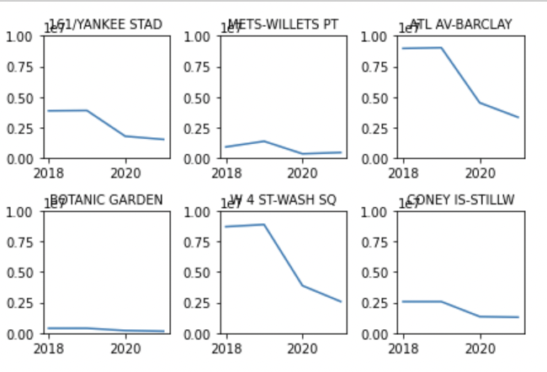
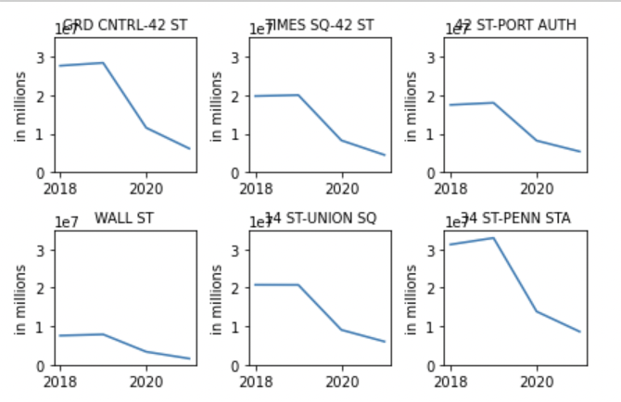
STATIONS OF INTEREST
All 12 stations selected for a deeper look followed the same pattern as the overall city, with about a third as many rides in 2020 & 2021 instead of 2018 & 2019.
⬇️ The top row below consists of hubs on 42nd street, and the 2nd row contains other transportation centers in lower Manhattan. (Penn Station also doubles as a sports center with Madison Square so close by.) It is no surprise they followed the same pattern as the overall city; 4 out of 6 are in the top 5 biggest NYC stations.
⬆️ The top row of this subset contains the city’s other biggest arenas: Yankee Stadium, Citi Field, and Barclays Center. Beneath that are a couple popular parks and attractions. Regardless of range, the pattern remained consistent; 2020 & 2021 had a 1/3 as many rides.

Slide 5
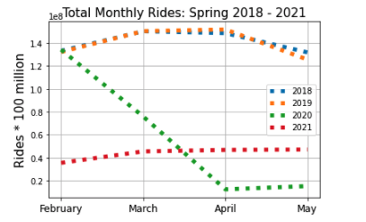
Monthly Spring Rides (Per Year)
The table on the right gives a peek into how the individual months in our 4 years performed.
2020 started off along the same line as 2018 & 2019, but as expected took a drastic plunge in March 2020.
2021 is as steady as 2018 & 2019, but with 1 million fewer rides across the board.

Slide 6
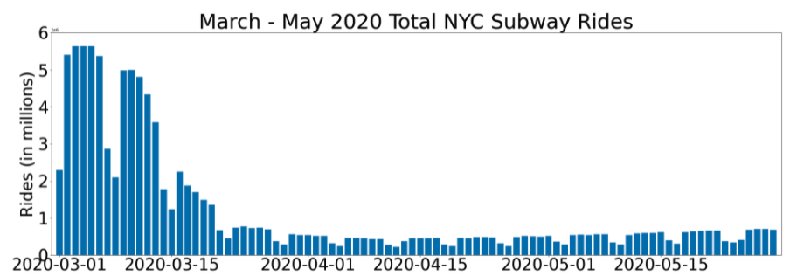
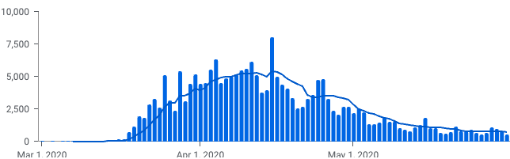
2020 Daily Rides vs New COVID Cases
The bottom screenshot of the new daily COVID cases in NYC from Google News provides a perfect inverse relationship (and therefore explanation) for the ride decrease seen in the last chart and the one on this slide.

Slide 7
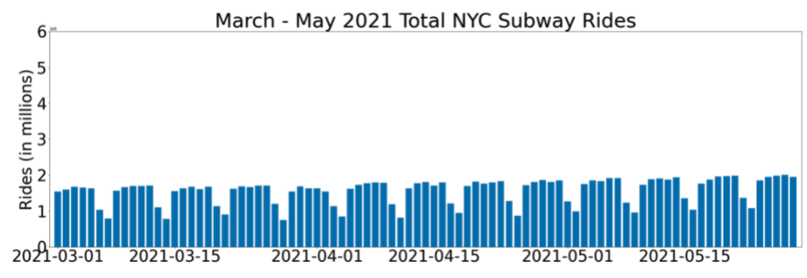
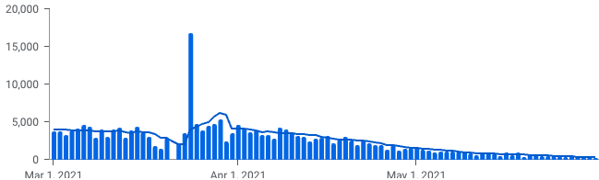
2021 Daily Rides vs New COVID Cases
As stated in the “Monthly Spring Rides” slide, 2021 saw steady ridership trends.
COVID rates were similarly steady, aside from a Delta spike in March 2021.
The top chart helps visualize how Saturday & Sunday’s shorter bars compare to the rest of the week.

Slide 8
Conclusions & Future Work
Subway ridership trends followed patterns much more tightly than expected.
The MTA should be prepared to run at at least 1/3 regular capacity to maintain efficiency.
Future work will include massaging & analyzing time frame data and if these trends apply to rush hour or weekend activity.

